Slide 1
Building a Criteria Spreadsheet for Instructional Decision Making

Slide 2
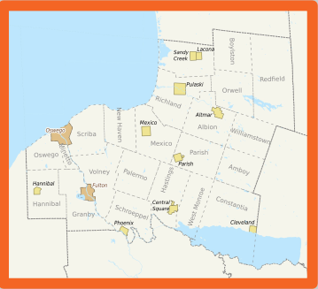
Phoenix Central School District
● 3 buildings:
○ Michael A. Maroun Elementary (K-4)
○ Emerson J. Dillon Middle School (5-8)
○ John C. Birdlebough High School (9-12)
● 30 minutes north of Syracuse
● Approximately 1,750 students
● Over 50% Free and Reduced Lunch

Slide 3
The Issues
Gave multiple assessments
Data was housed in multiple locations
Needed a way to compare students across the grade levels
Needed to be “our” kids instead of “my” kids
Recognized the need to use assessments to drive our instruction and interventions

Slide 4
The Why
Instructional planning and allocation of resources
Global picture of student achievement and growth data
Creating consistency across the district

Slide 5
The Assessments
NWEA MAP
aimswebPlus
Common Formative Assessments
State Assessments

Slide 6
NWEA MAP
Benchmarking
Computer adaptive
Measures what students know regardless of their grade level
Measures growth over time and across school years
Standards driven

Slide 7
aimswebPlus
Benchmarking and progress monitoring
Brief, reliable measures of foundational skills in reading and math
Tracks students progress across school years
Skill driven

Slide 8
Common Formative Assessments
Determined that CFA’s would measure student learning using the same:
instrument
process
scoring criteria
test administration

Slide 9
Common Assessments in Action-Next Steps:
What power standards or learning targets were measured?
What areas did students do well with?
What skill deficiencies do we see?
What patterns do we see in the data?
What groups can be formed based on this assessment?
What instructional strategies helped students do well?
What interventions are appropriate based on the data?
Do we need to tweak or improve this assessment?
What is our plan for extending & enriching learning?

Slide 10
State Assessments
Demonstrate how schools are progressing with the learning standards
Designed to measure how well students are mastering the learning standards

Slide 11
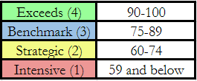
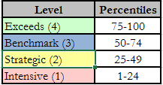
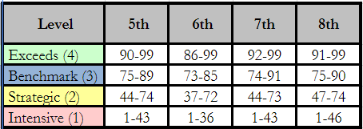
The Ranges
Old Ranges
CFA’s
MAP ELA
New Ranges
All assessments

Slide 12
Gathering Data
NWEA MAP
aimswebPlus
Common Formative Assessments
State Assessments

Slide 13
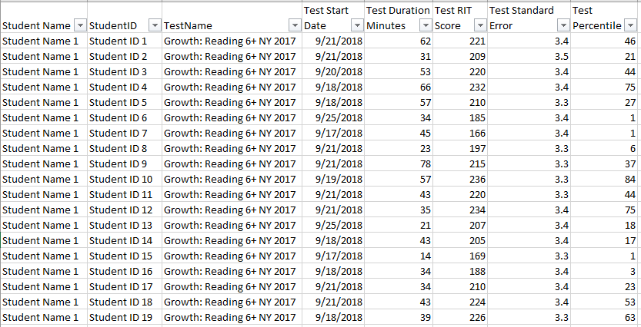
NWEA MAP

Slide 14
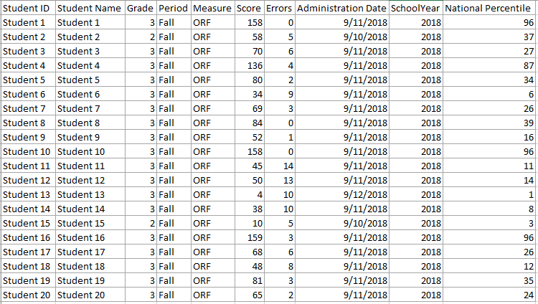
aimswebPlus

Slide 15
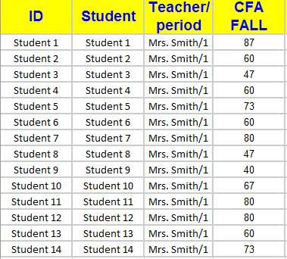
Common Formative Assessments

Slide 16
The Other Important Information
Identifying 504 and IEP students
Identifying interventions and other supports

Slide 17
The Criteria Spreadsheet Revisited
Common Formative Assessments
Roll out across the district
Sharing data with teachers

Slide 18
Data is valuable, so let’s be mindful of how we’re sharing it.
Clara Shih

Slide 19
The Criteria Spreadsheet

Slide 20
Example

Slide 21
Formulas Used
Index Match
=iferror(index(the data you want,match(select ID column from spreadsheet,select ID column from data sheet,0)),” “)
Including Range Data =IF(AND(B2>=0,B2<=24),1,IF(AND(B2>=25,B2<=49),2,IF(AND(B2>=50,B2<=74),3,IF(AND(B2>=75,B2<=100),4,"No Data"))))

Slide 22
Utilizing the Spreadsheet
How we have used it
Moving forward
Next steps

Slide 23
THANKS!
Any questions?
You can find us at:
Nicole Covell- ncovell@phoenixcsd.org
Stacie Shaffer- sshaffer@phoenixcsd.org

